Slide 1
SparConvLow
IEEE TNNLS, VOL. 36, NO. 7, JULY 2025
Integrating Convolution and Sparse Coding for Learning Low-Dimensional Discriminative Image Representations
Xian Wei, Yingjie Liu, Xuan Tang, Shui Yu, Mingsong Chen · East China Normal University
Notes:
One sentence: the paper builds one network that extracts CNN features, compresses them, turns them into sparse codes, and projects them into a small space where classes separate, all trained together.

Slide 2
The problem and the research gaps
Goal: turn images into small feature vectors in which different classes are easy to tell apart.
1. Too many dimensions
2. Two-stage pipelines
3. Shallow or single-prior
CNN features are huge (25,088 values for VGG-16). Sparse coding directly on them is very costly and needs far more samples.
Earlier CNN plus sparse coding work trains the CNN and the sparse coder separately, so nothing is optimized globally.
Classic dimension reduction (LDA) is linear, dictionary learning struggles on real photos, and CNNs score images one by one.
Notes:
Plain-language version: CNNs are strong but ignore relations between images; sparse coding and LDA capture structure but cannot handle raw photos. Nobody had trained all of them jointly in a differentiable way.

Slide 3
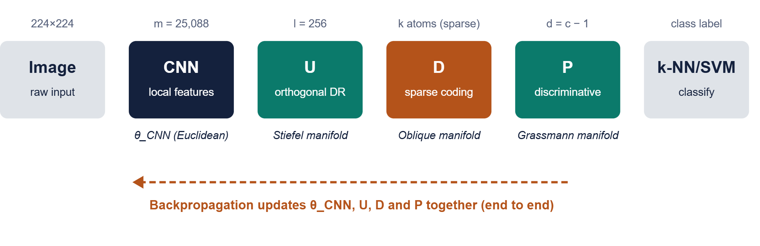
Architecture: the SparConvLow pipeline
Notes:
Walk left to right. The CNN gives a long feature vector x. U shrinks it to x-hat = U^T x. Sparse coding expresses x-hat as a few atoms of dictionary D, giving code phi. P projects phi into c-1 dimensions, where a simple k-NN or SVM classifies. Each colored matrix lives on a manifold, a curved space of matrices with a constraint.

Slide 4
SparDR module: three learned matrices
U · Stiefel
D · Oblique
P = VVᵀ · Grassmann
Compresses features from m ≈ 25,088 to l = 256 so sparse coding is affordable. Orthonormal columns (UᵀU = I) keep information.
Dictionary of k atoms with unit length. Each image gets a sparse code φ, found with an elastic-net (ℓ1 + ℓ2) penalty.
Projects φ down to d = c − 1 dimensions. Only the subspace matters, not its rotation.
One objective for everything: a trace quotient
maximize tr(Φ A Φᵀ P) / tr(Φ B Φᵀ P + σI)
A = between-class spread, B = within-class spread, as in LDA. SDA adds unlabeled images through a graph.
Notes:
The key trick: sparse codes are differentiable functions of the input, U and D, so gradients can pass through them. The objective is LDA-like: push class means apart, keep same-class samples tight, but measured on sparse codes instead of raw features.

Slide 5
Implementation: geometric SGD, one batch at a time
1
2
3
4
5
6
Take a mini-batch of images
Solve sparse codes (elastic net)
Compute gradients of the trace quotient
Project them onto the manifold tangent space
Retract: step, then snap back onto the manifold
Backpropagate into the CNN, then repeat
Why manifolds? A plain gradient step would break orthogonality or unit-norm constraints, so every update is projected back onto the constraint set.
Setup: λ1 = 0.2, λ2 = 1e-7, l = 256, batch 64 or 256, CNN learning rate 0.01.
Notes:
Explain retraction as: take a normal gradient step, then fix the matrix so it again satisfies its constraint (QR factorization for U and P, column normalization for D). Code is on GitHub: MVPR-Group/SparConvLow.

Slide 6
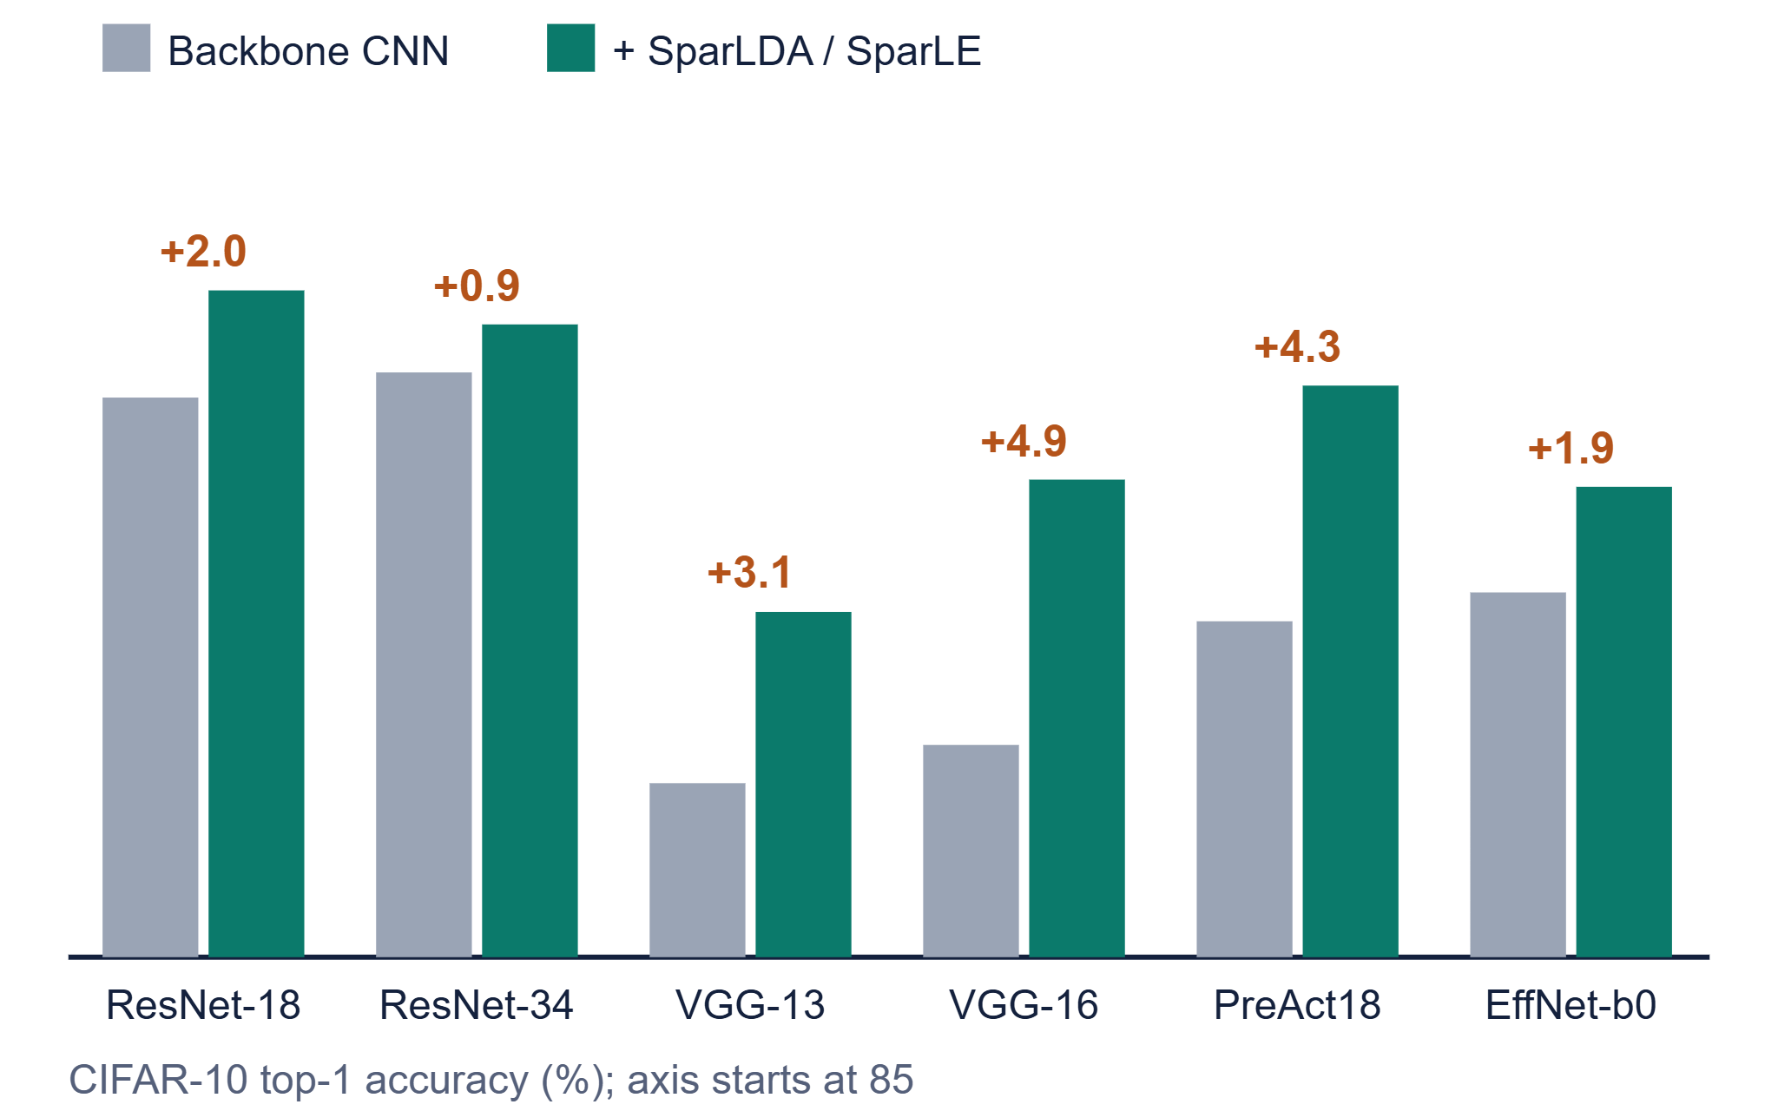
Results: gains on top of strong CNNs
99.25%
Fashion-MNIST accuracy with ResNet-18, up from 97.17%
4.68%
CIFAR-10 error with only 80 labels (FixMatch alone: 9.77%)
33.9%
ImageNet top-1 error, ResNet-34 at 15 epochs, down from 47.6%
Notes:
Numbers are from the paper's Tables II, III, V and VI. Gains are largest on weaker backbones (VGG) and when labels are scarce. The paper also reports SVHN (+1 to 2.7 points) and Caltech-101/256 improvements, and t-SNE plots showing tighter class clusters.

Slide 7
Summary
What it is
Why it helps
Caveats
A CNN, a sparse-coding layer and two orthogonal projections, trained end to end on matrix manifolds.
Sparse codes add discriminative structure, and the small output space separates classes, even with few labels.
Extra dictionary and sparse-coding cost, sensitivity to λ1 and dictionary size, and results reported by the authors.
Pitch: learn features that are convolutional, sparse and low-dimensional at once, in a single training loop.
Notes:
Future work named in the paper: unsupervised and zero-shot settings, deeper CNNs, and multimodal contrastive learning.

